Slide 1
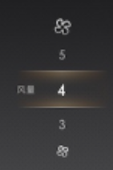
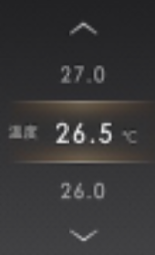
U611 MCA ICP Design Requirement
If continuous pressed #6 toggle up/down, IVI sent several events to RCCM
HMI pop up blower speed +/- change rate as 5 steps per 1 second, Control mirror time pop out is 2S.
Example: If continuous pressed Temp + , HMI change from 1 bar to 6 bar in 1 second
hardware
RCCM
1
2
3
4
Blower Speed Pop up
SYNC+ Screen
LIN
5
6
7
8
9
IVI
If continuous pressed #5 or #9 toggle up/down, IVI sent several events to RCCM
HMI pop up Driver Temp +/- change rate as 10 steps per 1 second, Control mirror time pop out is 2S.
Example: If continuous pressed Temp + , HMI change from 23.5C to 28.5C in 1 second, 0.5C per step
1). Mini ICP hardware connected for below buttons:
#1 Max Defrost, Touch button, hardware to RCCM
w/ indicator from RCCM feedback.
#4 Auto Start/Stop, Touch button, hardware to RCCM w/ indicator from RCCM feedback.
Temp Pop up
SYNC+ Screen
2). Mini ICP LIN to IVI for below buttons signal Transmit & Receive.
#2 Climate power on/off, Touch button, IVI to RCCM, w/ indicator from IVI.
#3 DAT, Touch button for DAT hot key, w/o indicator.
#4 Auto Start/Stop, Touch button, IVI to PCM, w/ indicator from IVI.
#5 Driver side Temp Up/Down, Hard toggle for driver side temp +/-, IVI to RCCM, w/o indicator.
#6 Blower Up/Down, Hard toggle to IVI , IVI to RCCM, w/o indicator.
#7 SDM, Hard toggle to IVI, IVI to ABS, w/o indicator.
#8 A/C on/off, Hard toggle for A/C(Control Compressor) on/off, IVI to RCCM, w/ indicator from IVI.
#9 Passenger side Temp Up/Down, Hard toggle to IVI , IVI to RCCM, w/o indicator.

Slide 2
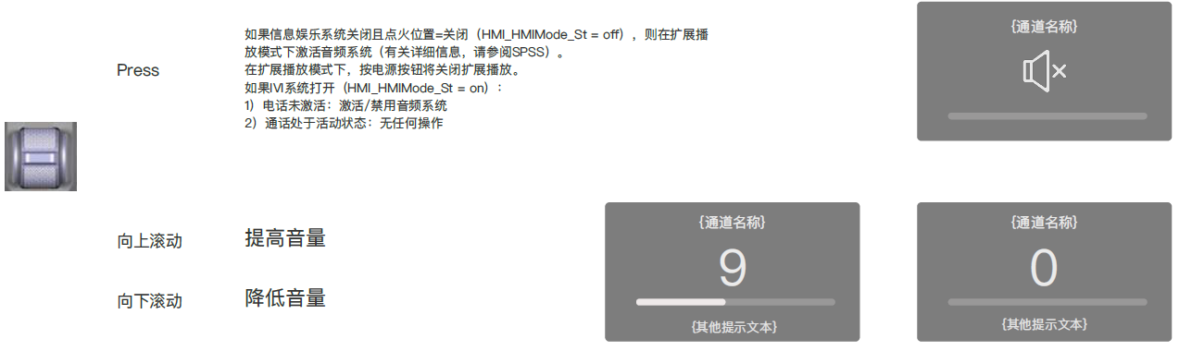
U611 MCA MFK Design Requirement
3). MFK hardware connected for below buttons:
#10 hazard, hard push button, hardware to BCM w/o indicator;
#11 parking menu, hard push button, hardware to ADAS w/o indicator;
10
hardware
BCM/ADAS
11
4). MFK LIN to IVI for below buttons signal Transmit & Receive.
#12 VOL, Hard Toggle button for volume +/-, be pressed for audio on/off, w/o indicator;
Short Pressed ON/OFF(ShortElapsed ) --- Audio on/off; Long Pressed(LongEvent) --- Audio Restart.
Short Pressed up(ShortElapsed ) --- Audio step up ; Long Pressed up (LongEvent) --- Audio up continuously (according to HMI design)
Short Pressed down(ShortElapsed ) --- Audio step down ; Long Pressed down(LongEvent) --- Audio up continuously (according to HMI design)
12
LIN
IVI
Bumper For Key Take Away, Need Capitalize Each Word

Slide 3
ICP signal description
Parts | 按键/旋钮 | 描述 | 按键ID/旋钮信号 | 指示状态信号 | IVI Tx, CAN | IVI Rx, CAN
ICP | Max Defrost | touch，开启/关闭最大Defrost功能 | Digital signal = low | Digital signal = high
 | Climate power on/off | touch，开启/关闭最大A/C | ICPBtnID Front_Power=254 | DSPLIlluInd7 | Frt_Btn_Status_1st | RCCM: Front_Power_Btn_Stt
 | DAT | touch，hot key开启大屏DAT界面 | ICPBtnID_DriverAssist=112 | 无
 | Auto Start/Stop | touch，关闭/开启自动启停功能 | ICPBtnID_AutoStopStart=113 | DSPLIlluInd6 | APIM_Request_Signals (0x105) → StopStrtDrvMde_B_RqBtn3 | PCM to APIM: Stop_Start_HS3 (0X166) → StopStrtDrvMde_D_Indic
 | Driver side Temp Up/Down | 向上拨动，调高主驾侧温度 | ICPBtnID drvtempup=253 | 无 | Drv_Set_Temp
 |  | 向上拨动，调低主驾侧温度 | ICPBtnID drvtempdown=252 | 无 | Drv_Set_Temp
 | Blower Up/Down | 向上拨动，风量增加 | ICPBtnID_BlowerUp=141 | 无 | Frt_Blower_Speed
 |  | 向下拨动，风量减少 | ICPBtnID_BlowerDown=142 | 无 | Frt_Blower_Speed
 | SDM | 向上拨动，切换至列表上一个模式 | ICPBtnID_SDMincrease=248 | 无 | SelDrvMdeSwtch_D_Stat8
 |  | 向下拨动，切换至列表下一个模式 | ICPBtnID_SDMdecrease=247 | 无
 | A/C on/off | 向上拨动，开启/关闭空调压缩机 | ICPBtnID_AC=250 | DSPLIlluInd5 | Frt_Btn_Status_1st | RCCM: AC_Btn_Stt
 |  | 向下拨动，开启/关闭空调压缩机
 | Pass side Temp Up/Down | 向上拨动，调高副驾侧温度 | ICPBtnID Psngrtempup=251 | 无 | Psngr_Set_Temp
 |  | 向上拨动，调低副驾侧温度 | ICPBtnID Psngrtempdown=249 | 无 | Psngr_Set_Temp
MFK | Audio ON/off | 按下，如果信息娱乐系统关闭且点火位置=关闭（HMI_HMIMode_St = off），则在扩展播放模式下激活音频系统（有关详细信息，请参阅SPSS）。 在扩展播放模式下，按电源按钮将关闭扩展播放。 如果IVI系统打开（HMI_HMIMode_St = on）： 1）电话未激活：激活/禁用音频系统 2）通话处于活动状态：无任何操作（在扩展播放模式下，将通话更改为隐私） | ICPBtnID_OnOff=31 | 无
 | Volume up | 向上拨动，音量+ | ICPBtnID_Volup=246 | 无
 | Volume down | 向下拨动，音量- | ICPBtnID_Voldowm=245 | 无

